Slide 1
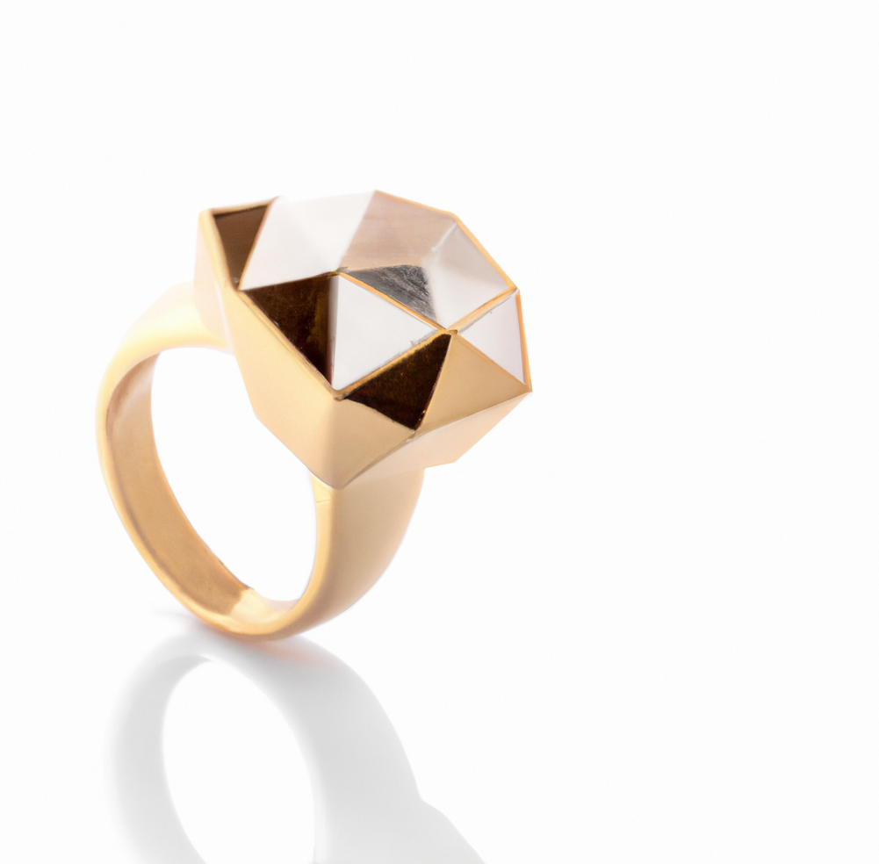
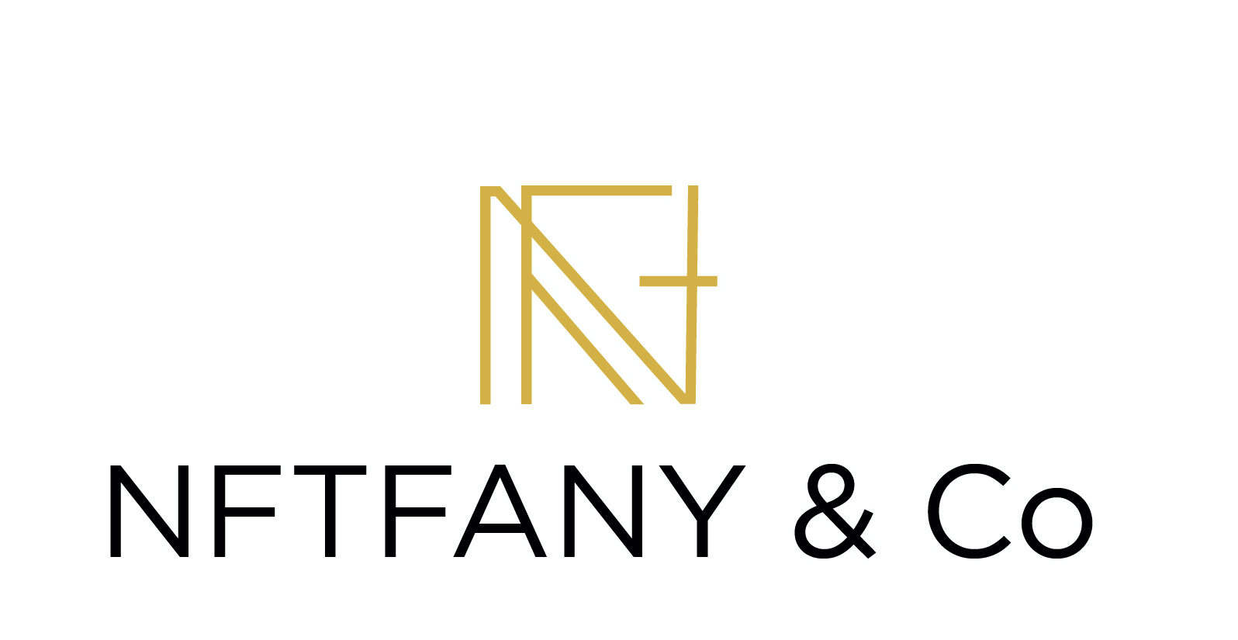
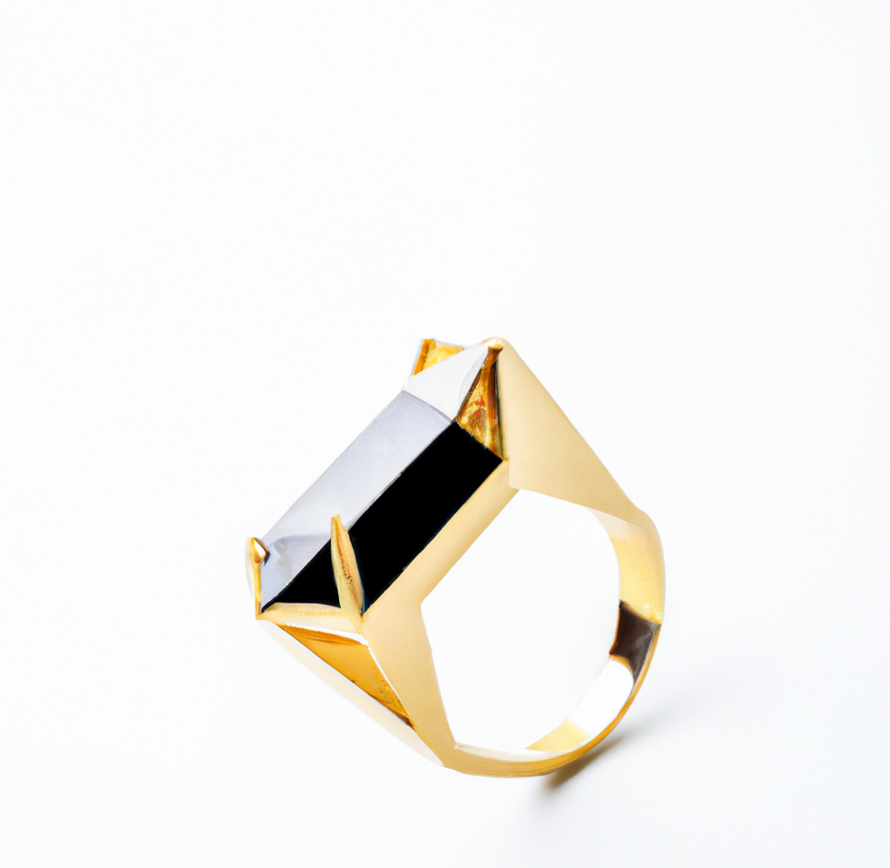
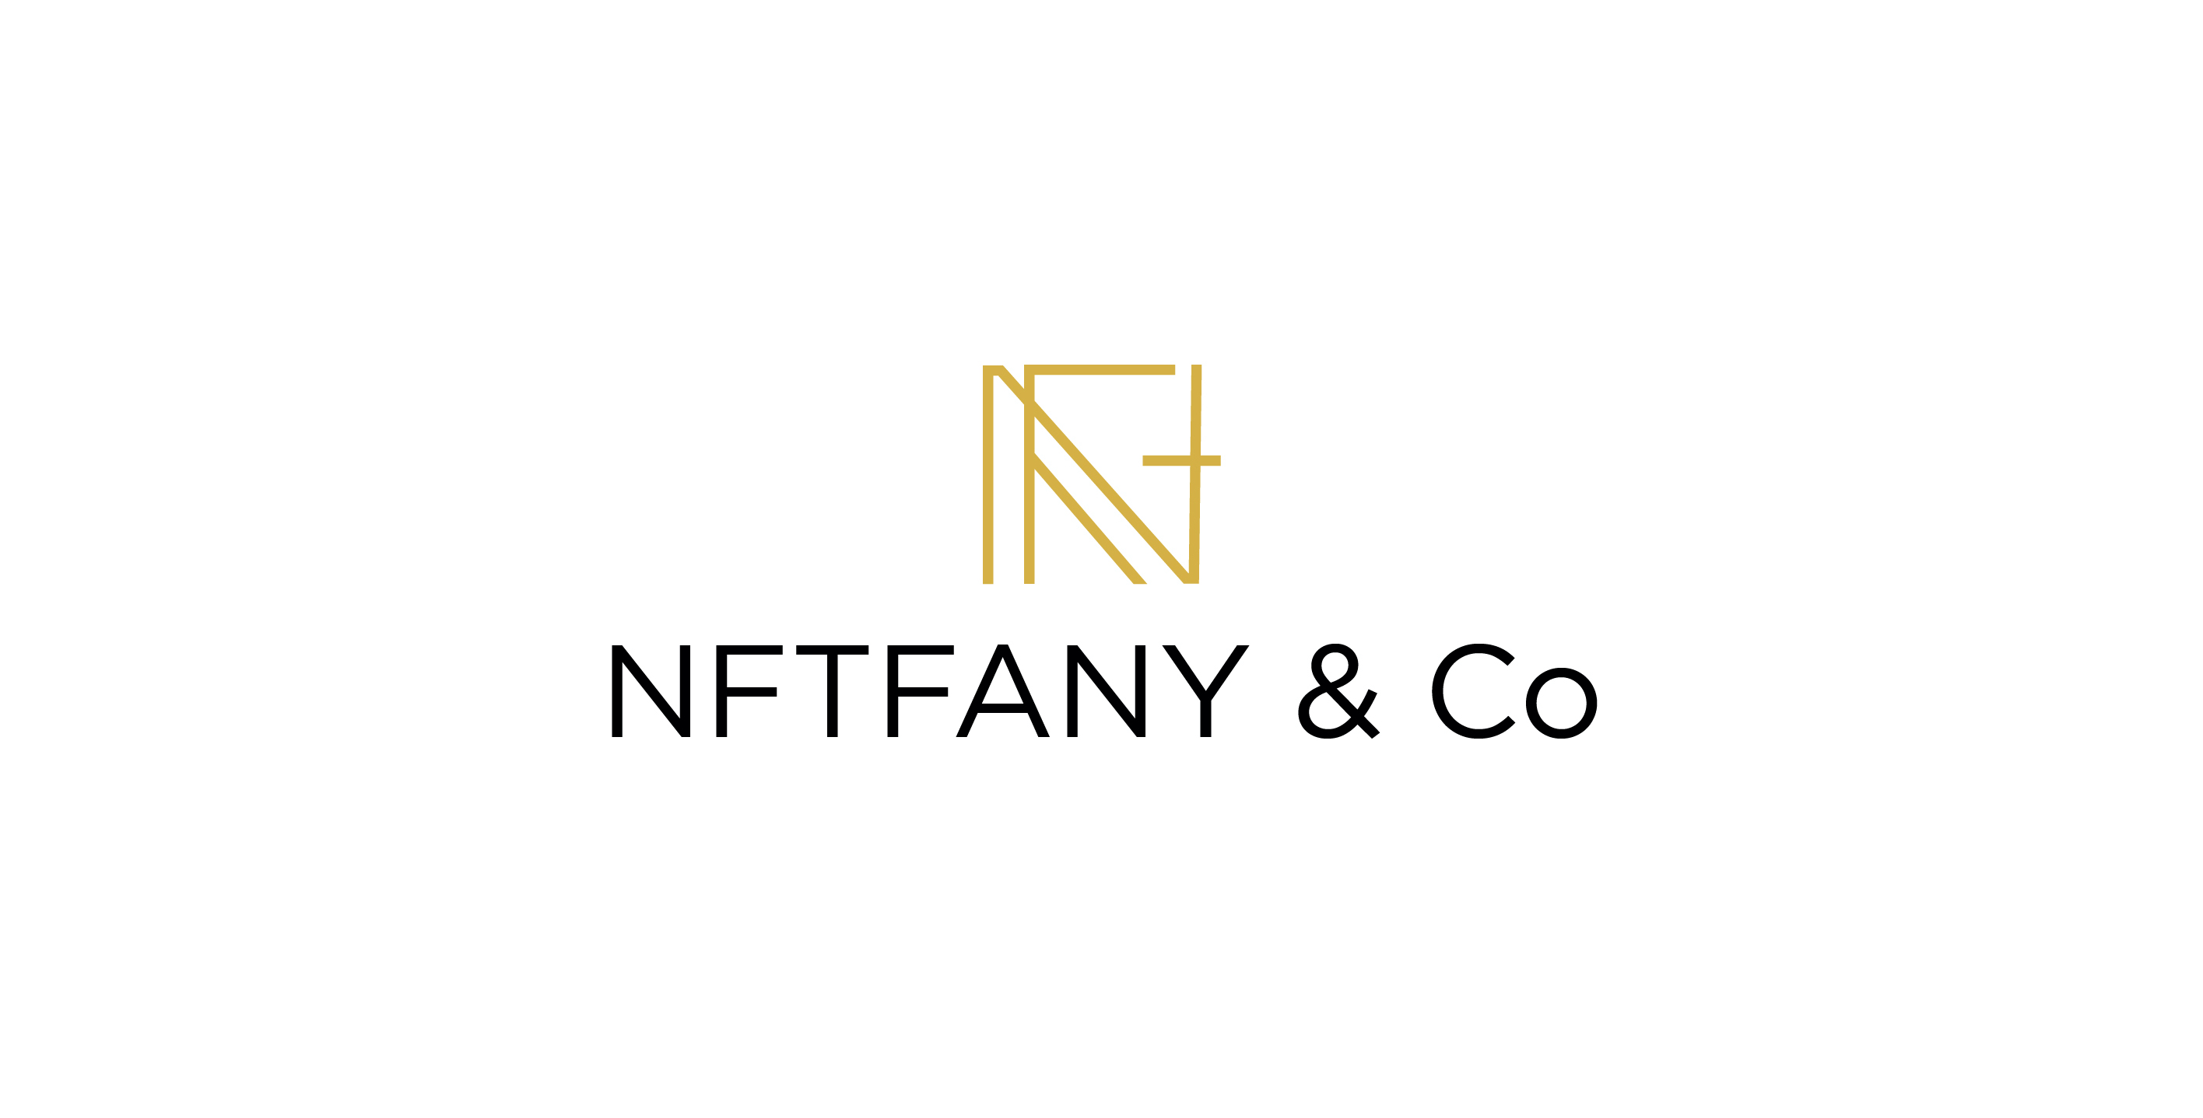

Slide 2
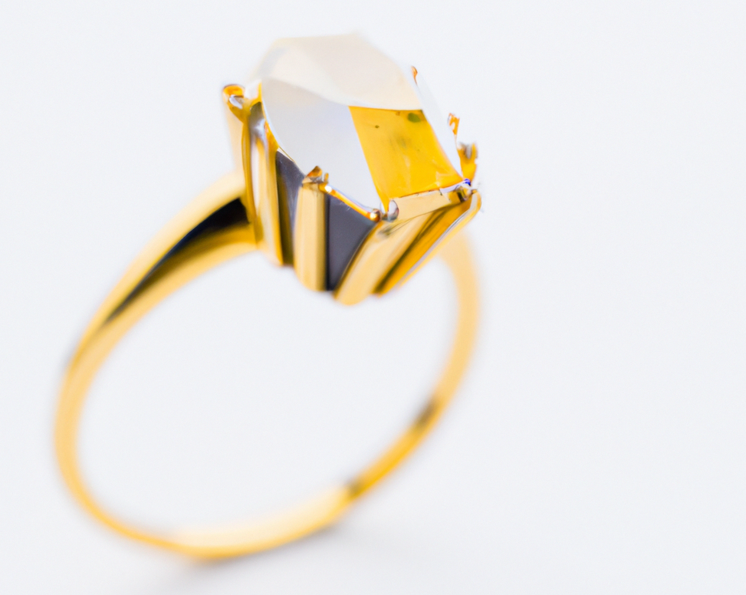

<
WHAT
>
NFTiffany & Co
IS?

Slide 3
The Mission
To be the metaverse jewellery manufacture leader for the blockchain's growing community
<
>
The Vision
To be the first metaverse NFT jewelry

Slide 4
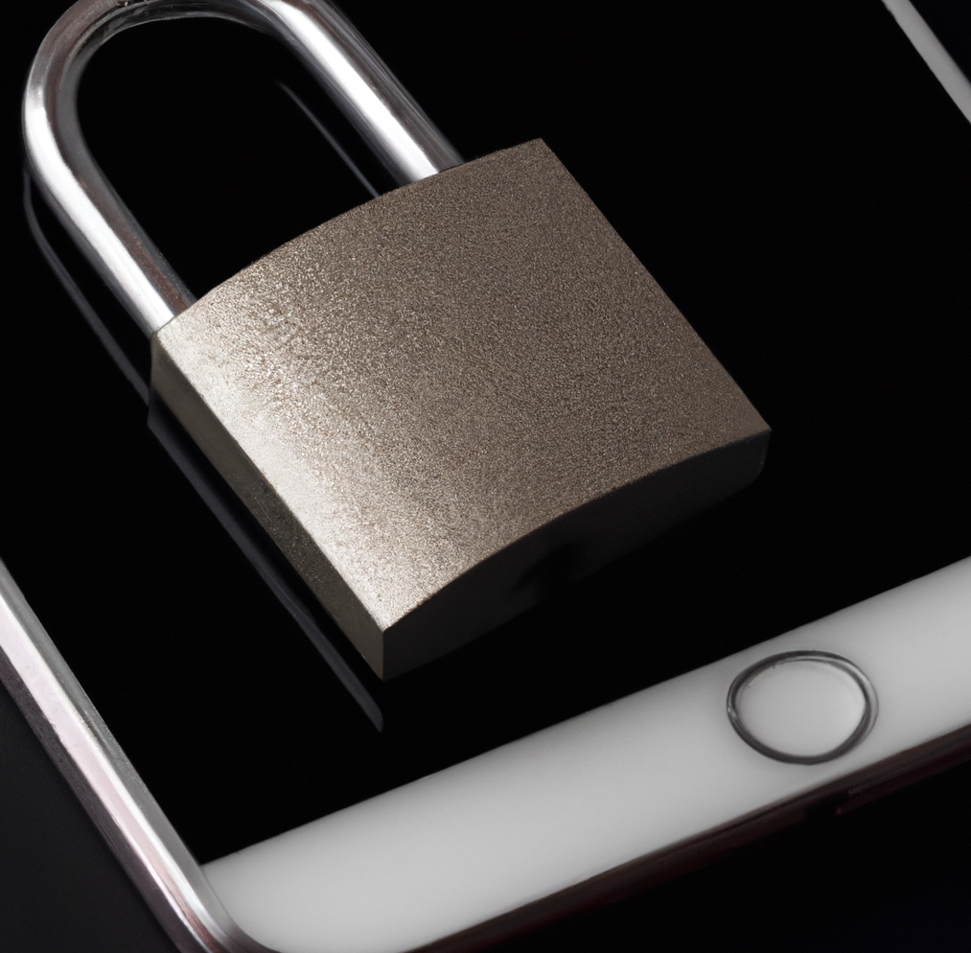
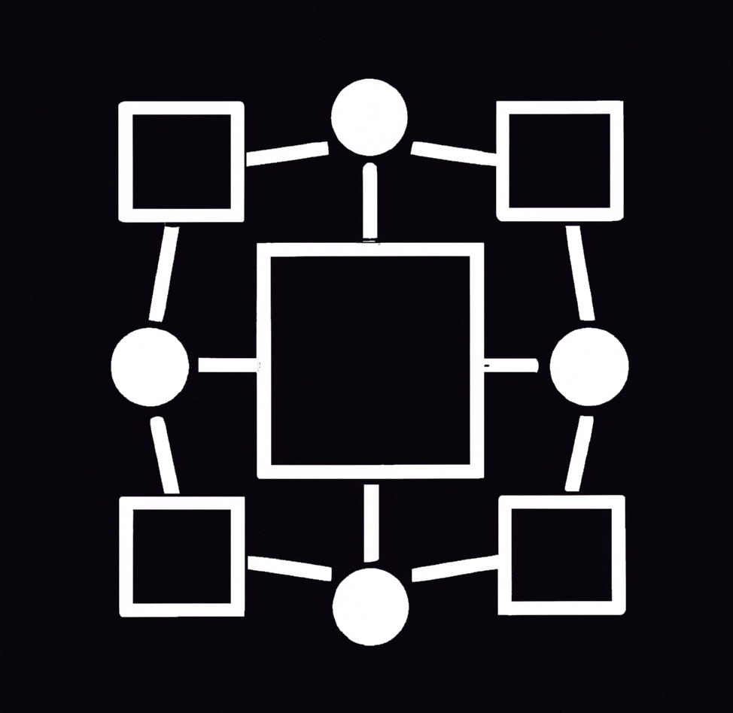
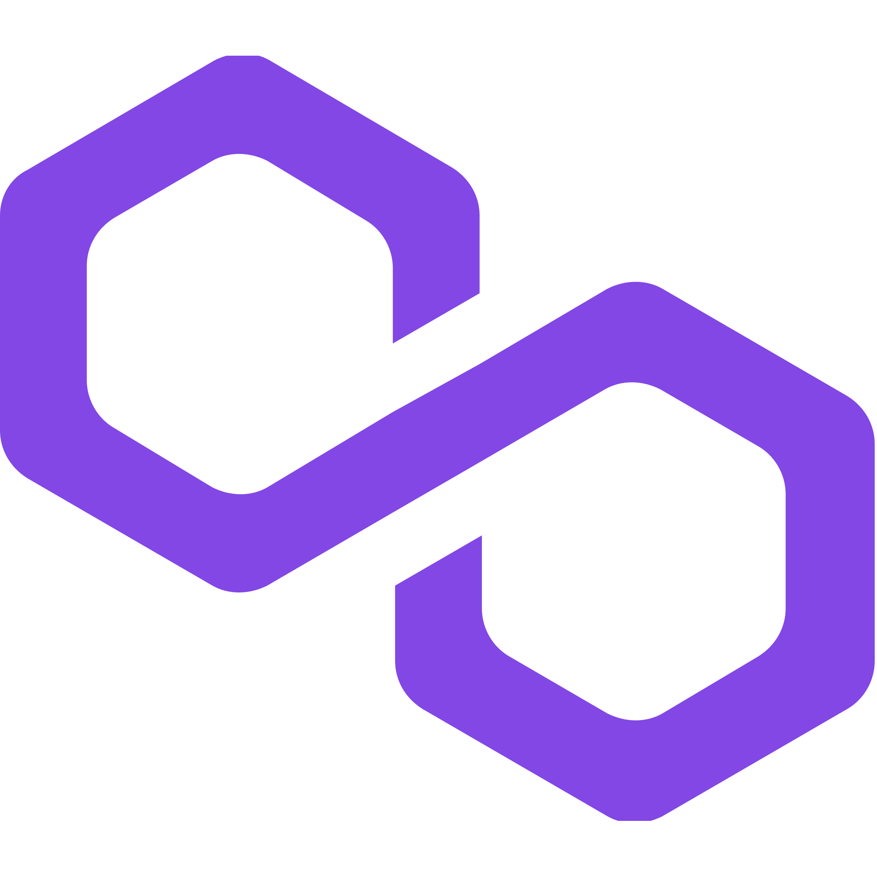
<
>
THE BACKGROUND
MULTIPLE BLOCKCHAINS
There is no blockchain that solves all the problems. Different blockchains solve different problems and therefore you have to make them communicate
SECURTY
Some blockchains (such as Ethereum and Bitcoin) are secure but slower and they should be used as a store value.
THE
TRADE OFF
POLYGON

Slide 5
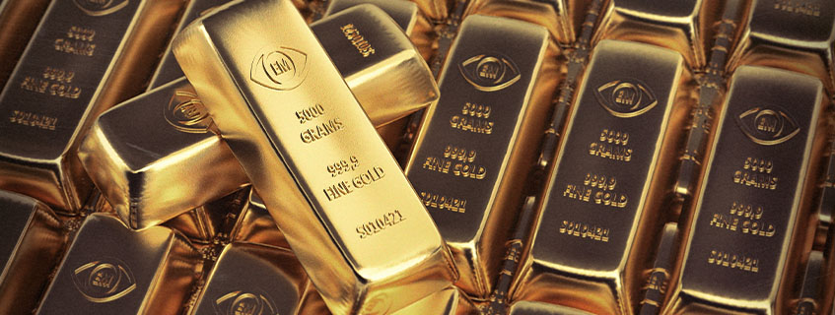
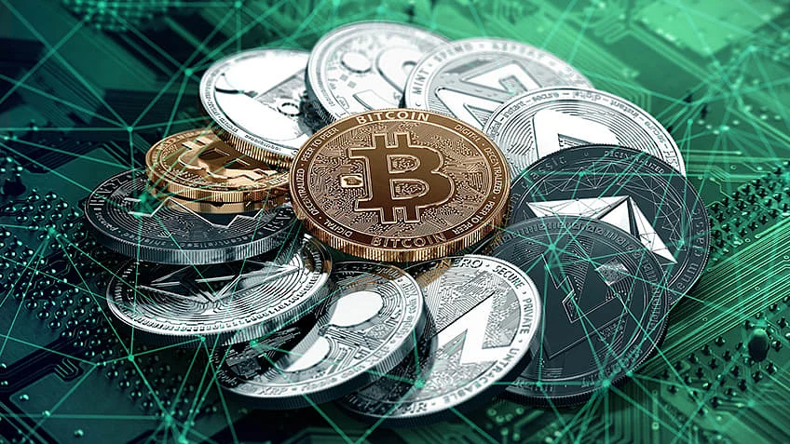
>
<
THE
IDEA
The idea is to use the analogy between precious metals (gold) and cryptocurrencies.
Just as jewels have always had an intrinsic value consisting of the value of the metal alloy, to which the skill of the jeweler is added, we have decided to re-propose this concept in the web world 3.
The innovation is to create the first completely digital web3 jewelery that , using the most precious cryptocurrencies, forge NFTs.

Slide 6
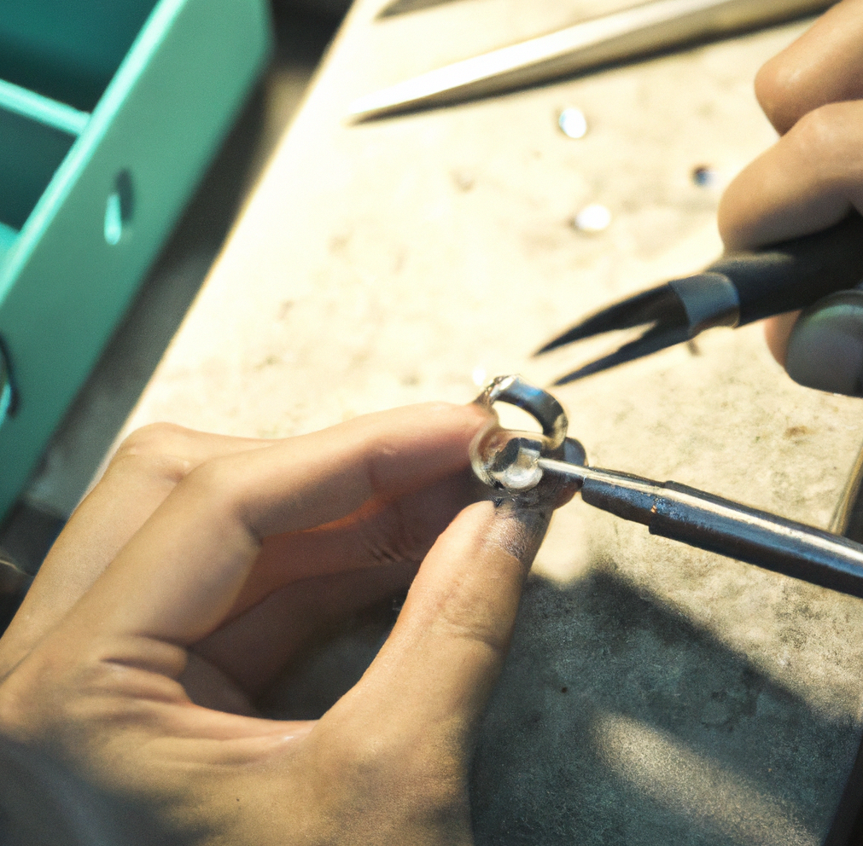
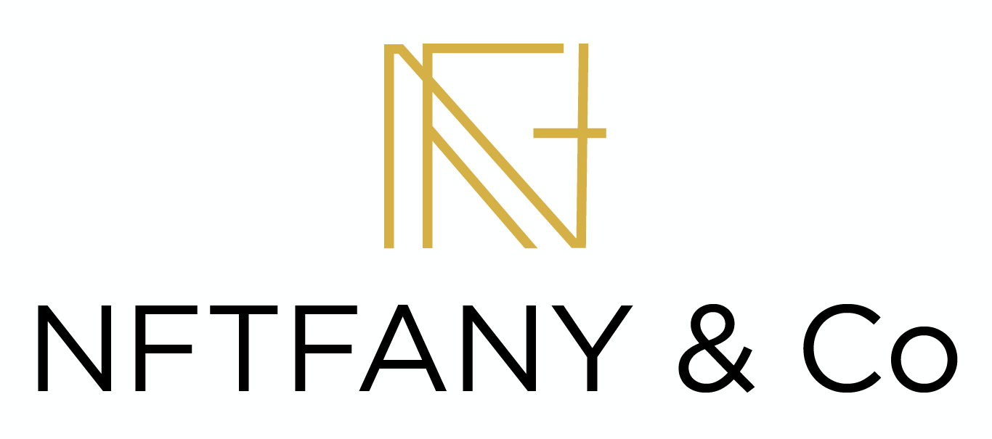
>
THE
>
PRODUCT

Slide 7
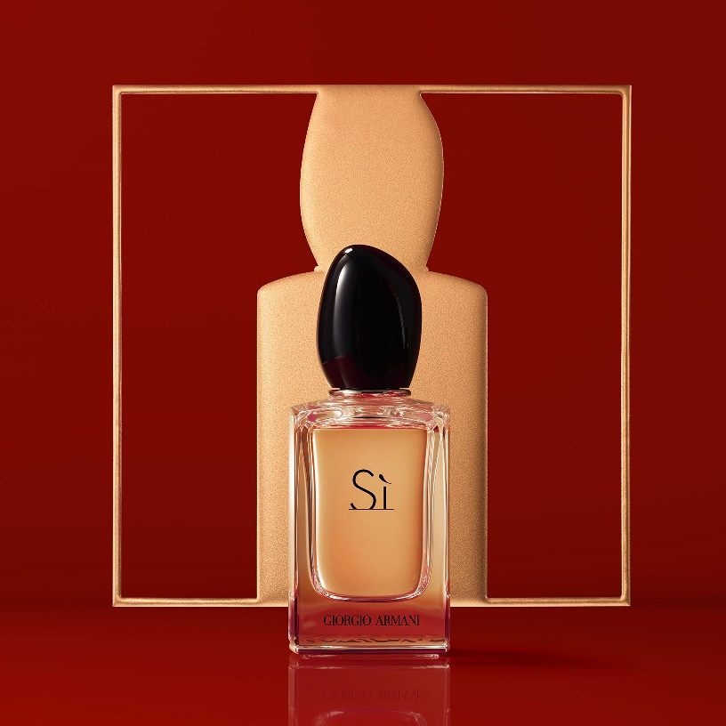
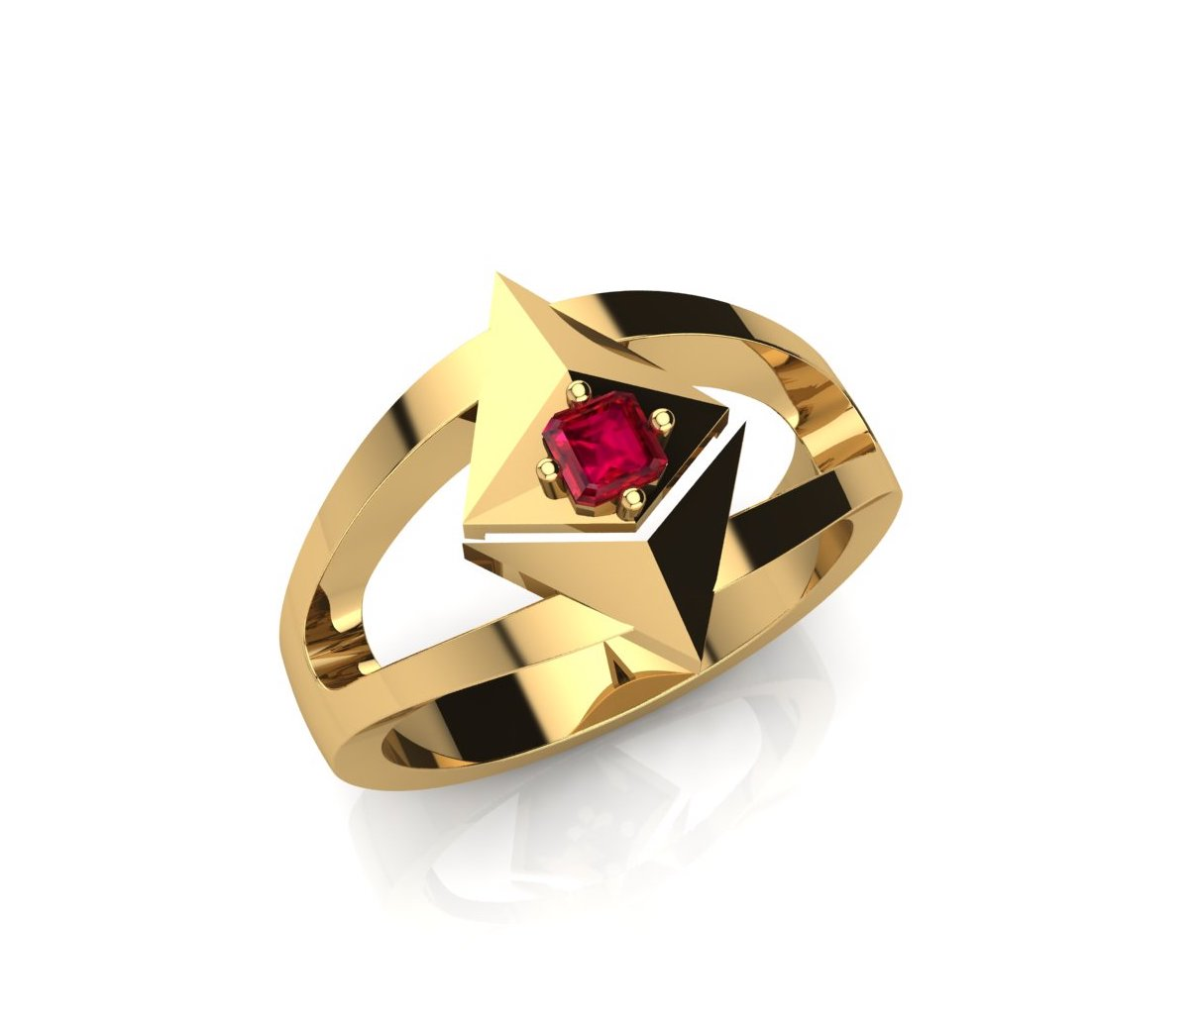
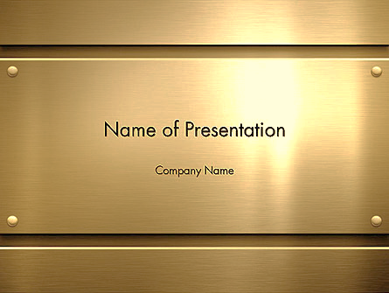
WHAT IS IT?
NFT who stores values
coming from
other chains

Slide 8
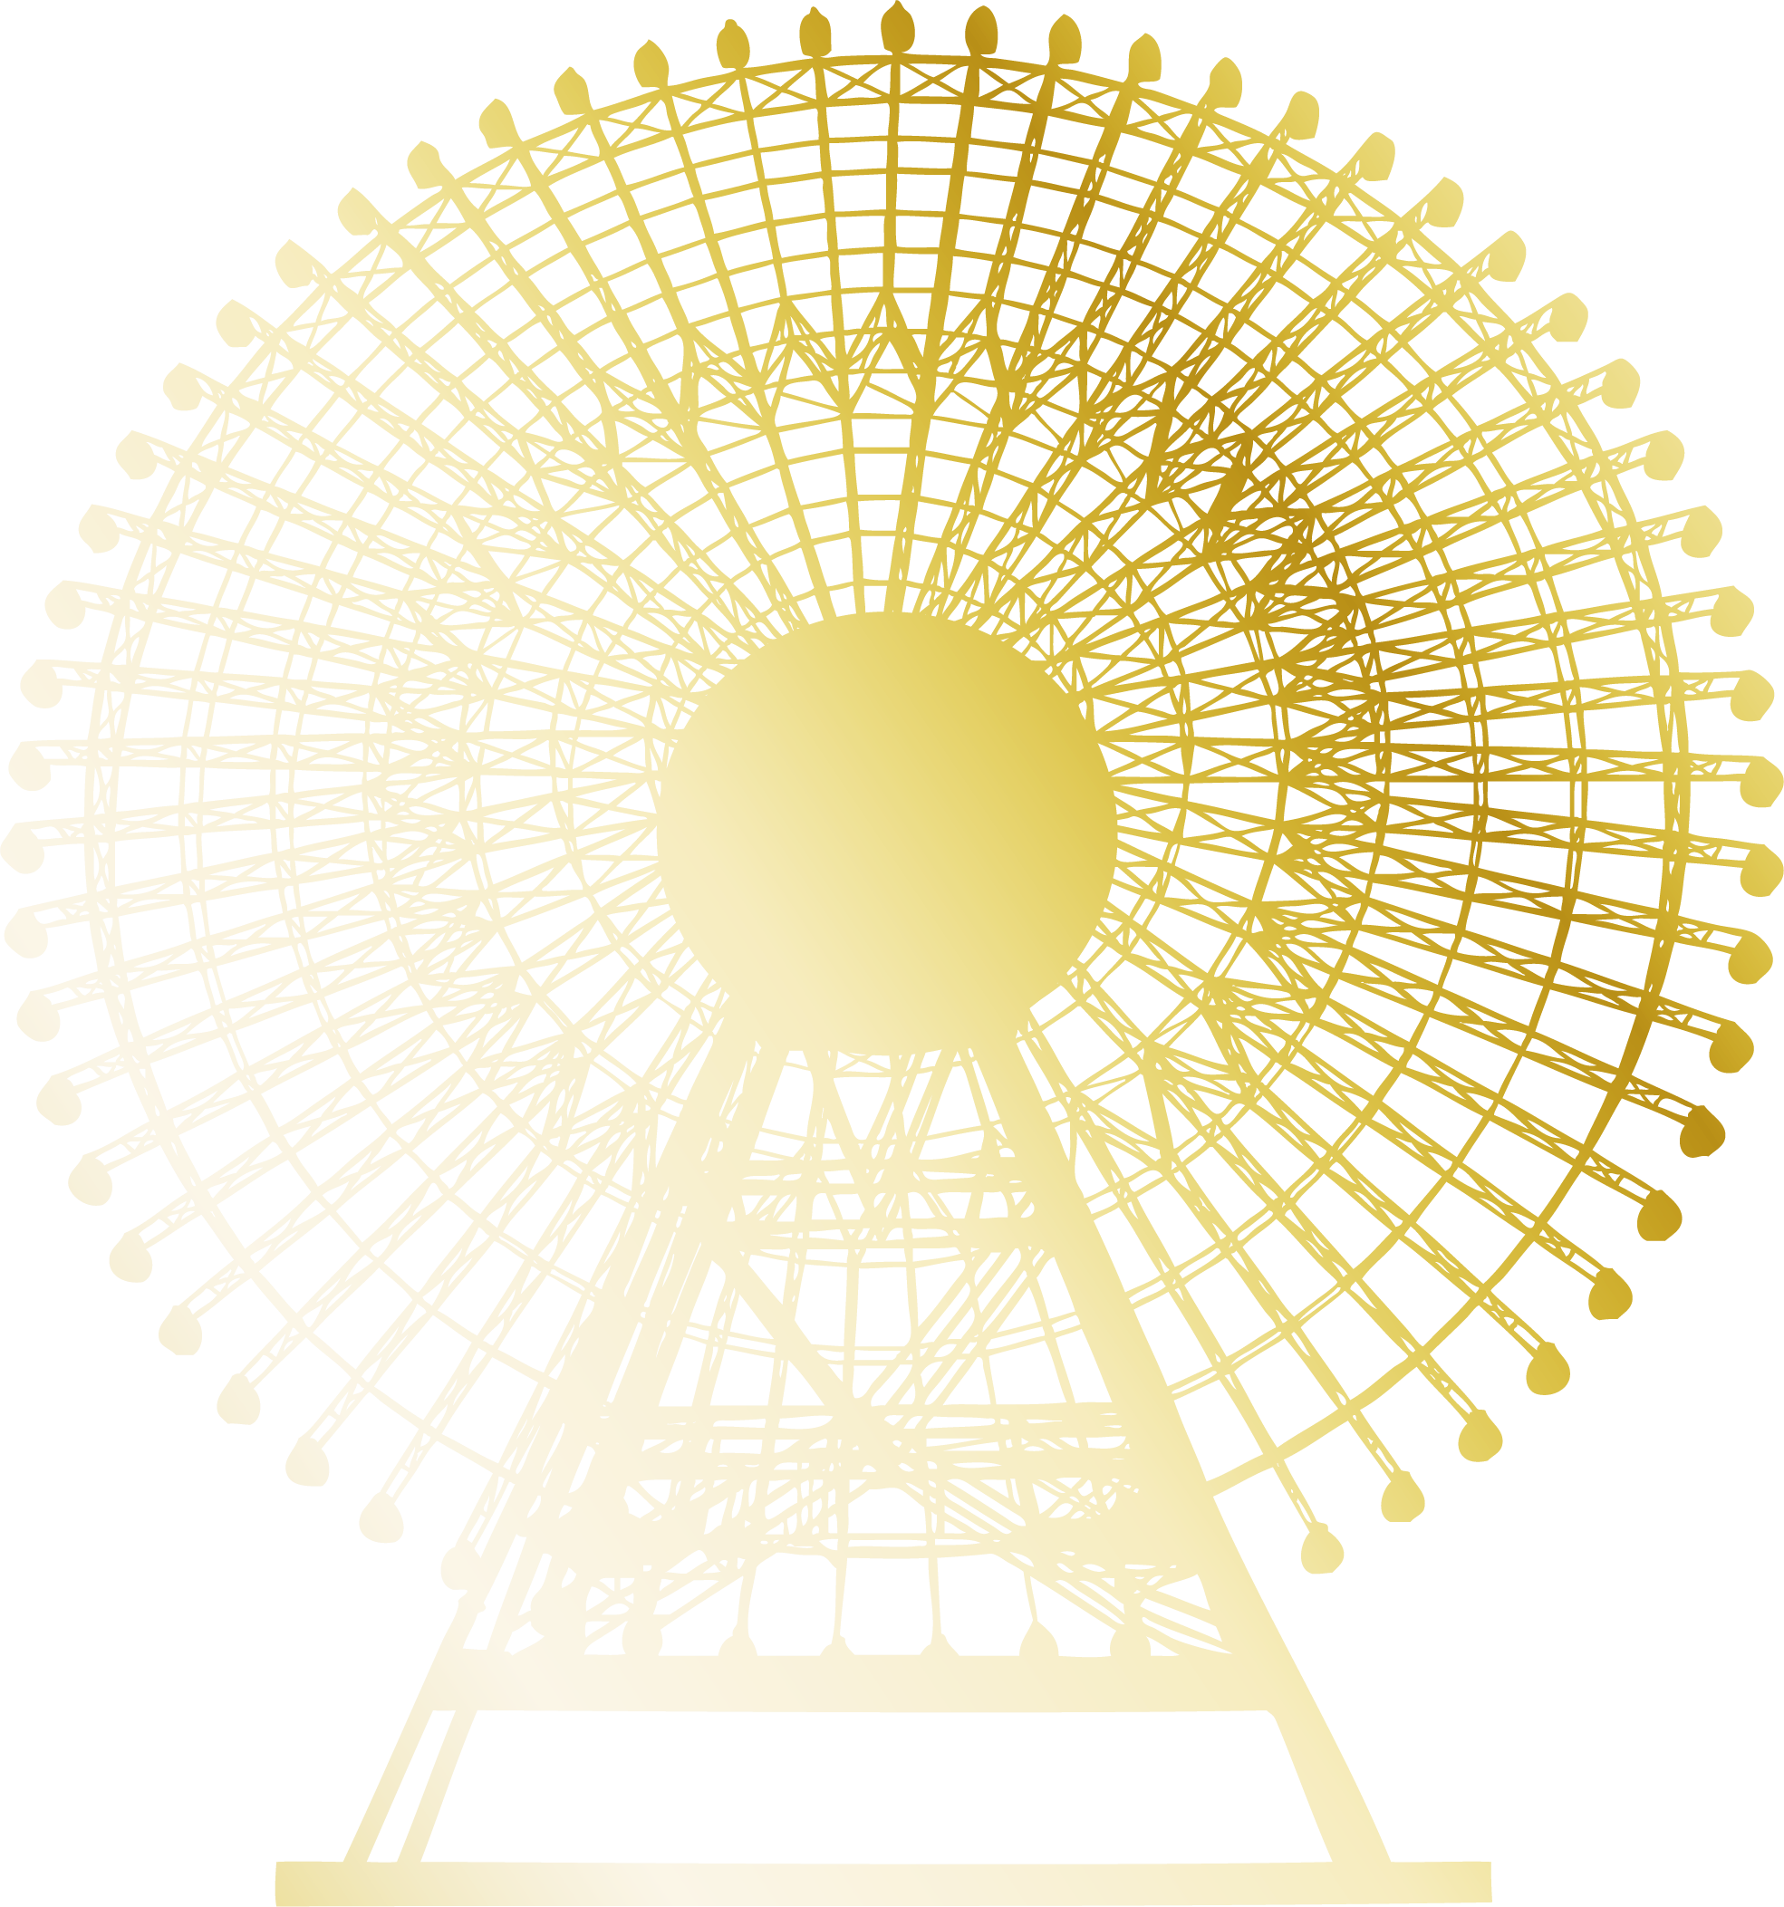
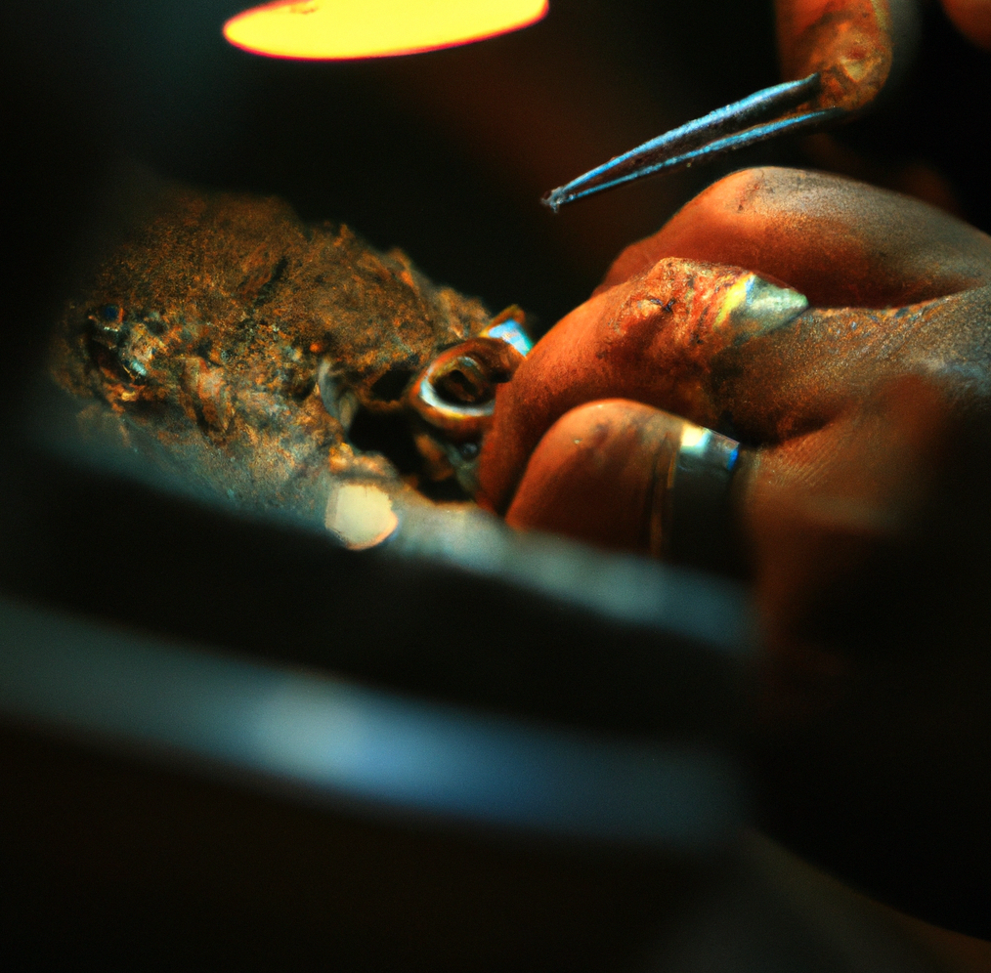
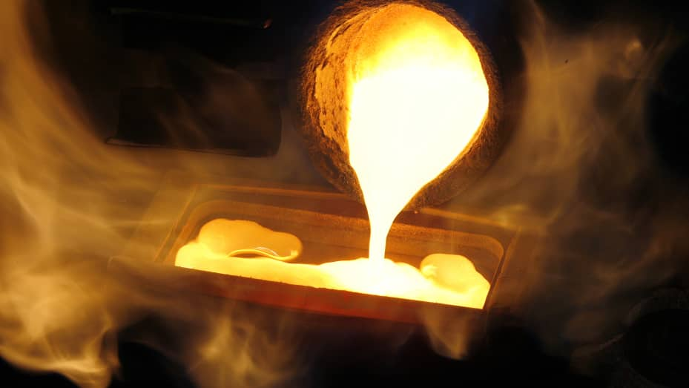
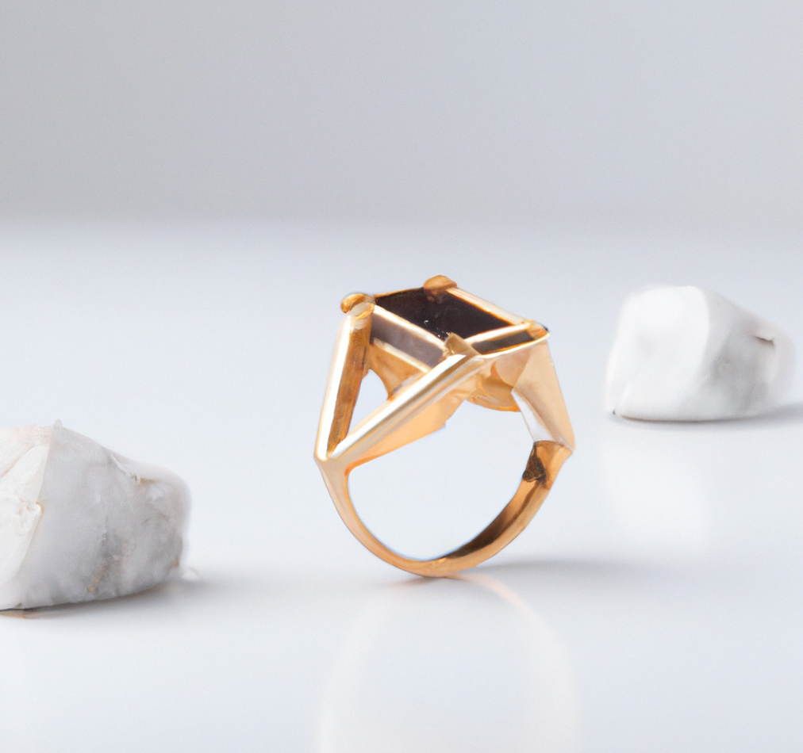
THE ITEM
THE VALUE
THE FORGE
THE FUSION
CIRCUITO
8 VETRINE
If a user believes that the intrinsic value of the NFT is greater than the intrinsic, he can make melt and regain possession of the material used to create the token. this can also be a way to move many different assets in a gas efficient way (only transfer to NFT)
A user can forge a ring using alloy, which is the native currency, by associating one or more gems that are token wrapped by other blockchains (Ex: wrapped Uniswap on ethereum)
NFT price can be volatile, but if they are used as store value of different assents from different chains they can stabilize their price

Slide 9
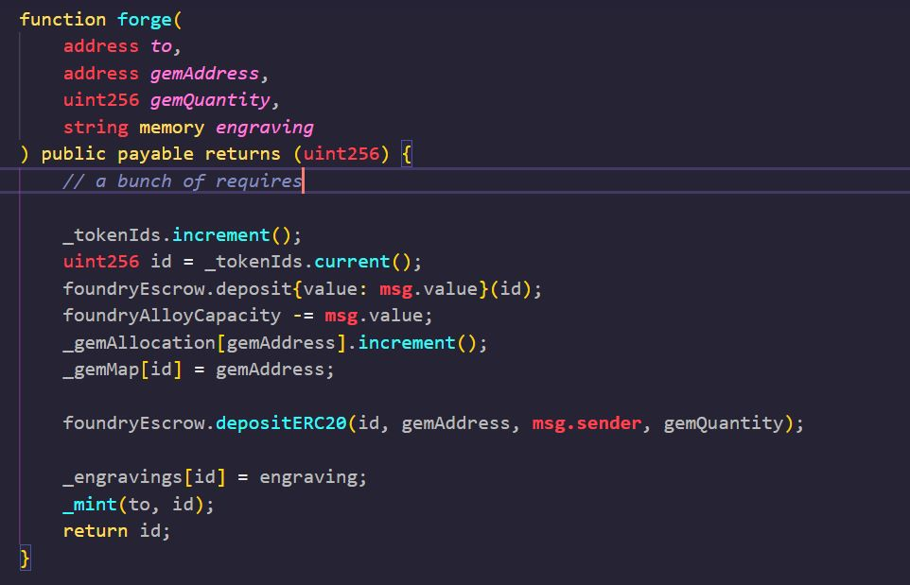
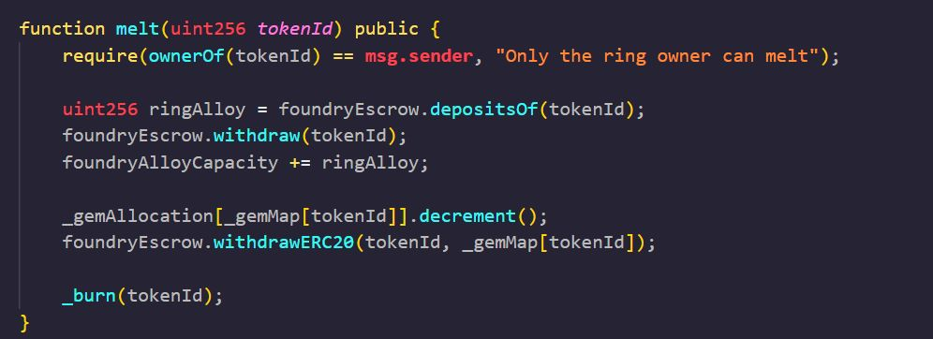
The key functions of the smart contract foundry
FORGE (Mint wrapper)
MELT ( _BURN WRAPPER)

Slide 10
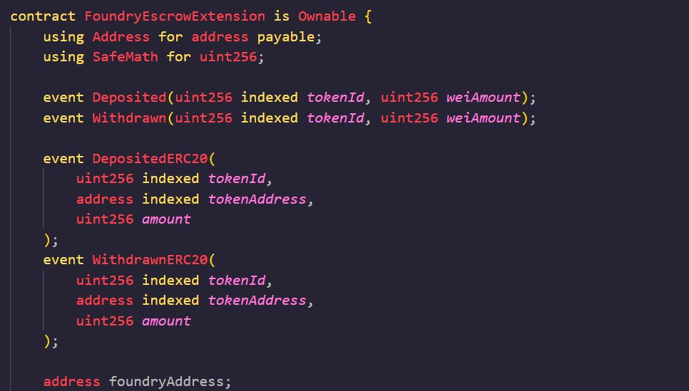
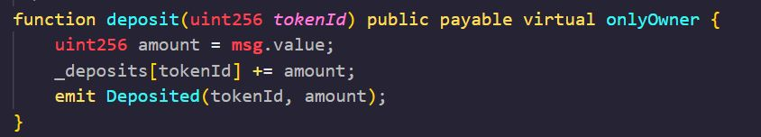
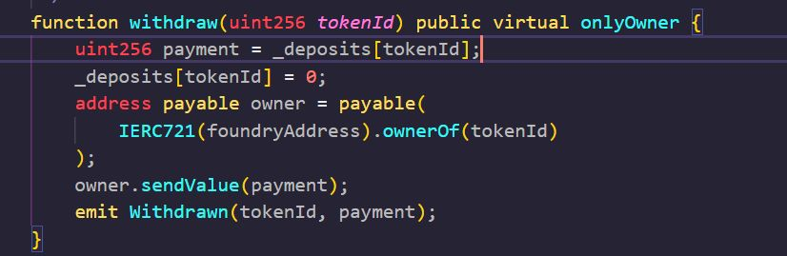
The key functions of the smart contract foundry
We have extended and reimplemented the openzeppelin escrow contract to function as a vault that deposits or returns alloy (native currency i.e. matic) and gems (erc20) to the owners of the nft instead of to the message.sender

Slide 11
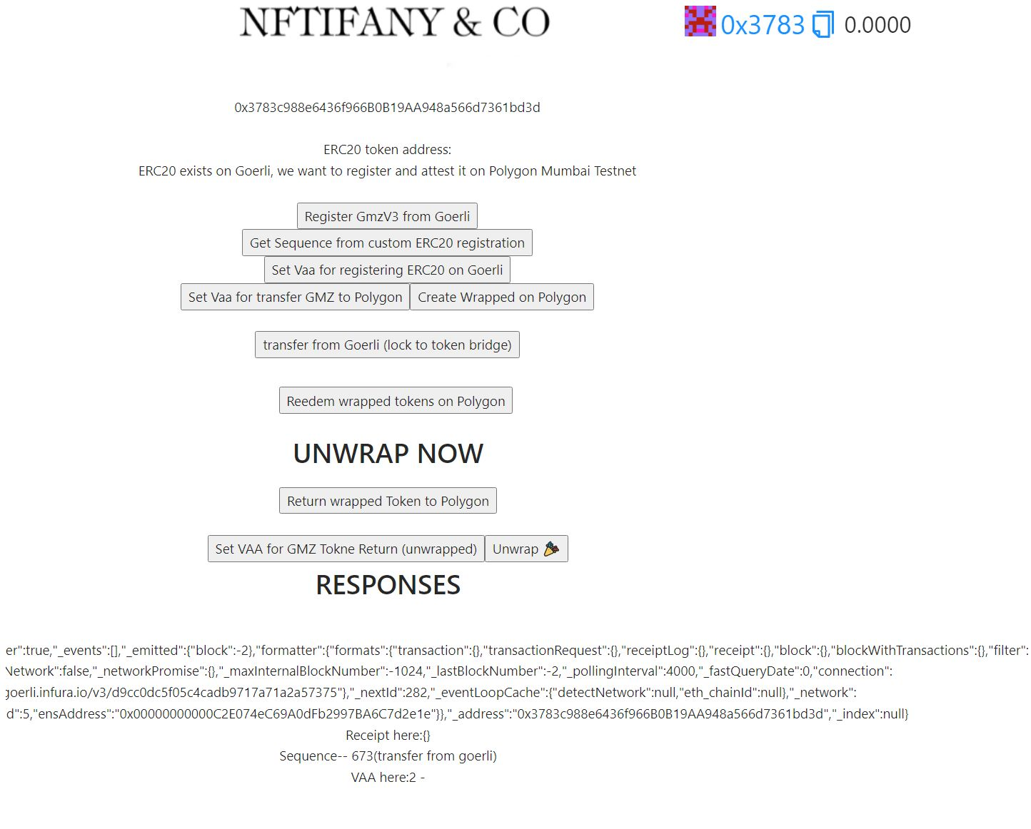
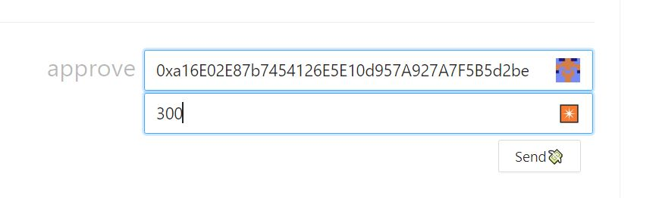
THE DEMO
IN STORE
VISIBILITY
CARTELLO GWP

Slide 12
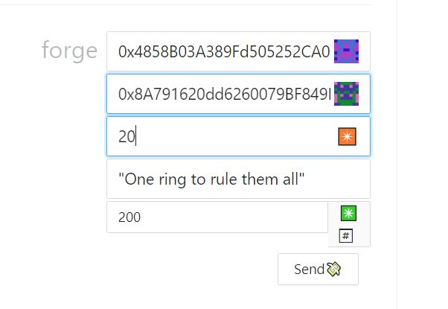
THE DEMO
PROOF OF CONCEPT
EXAMPLE
This is proof of concept of how we can wrap in tokens on ethereum and bring it to Polygon for gems
Using the Wormhole protocol which is compatible with Polygon
The owner of the wrapped token allows the Foundry vault to spend up to 300 tokens

